Slide 1
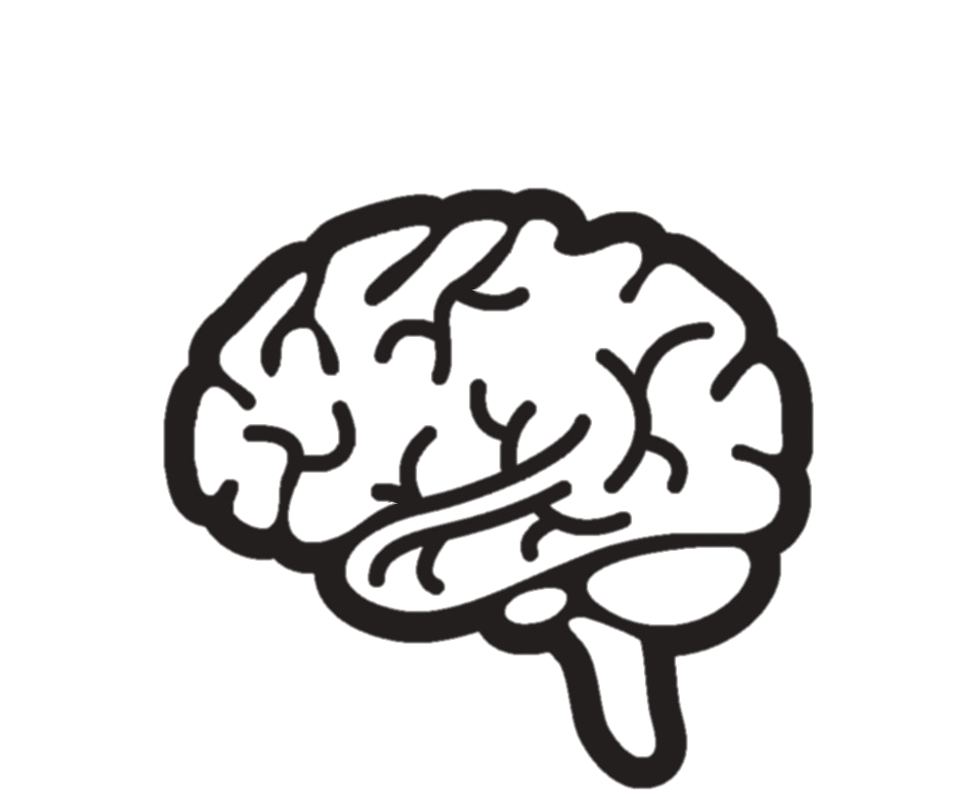
ADHD

Slide 2

Define ADHD
Attention Deficit Hyperactivity Disorder (ADHD) is a neurodevelopmental disorder that includes symptoms such as ​
→ Inattentiveness​
→ Hyperactivity​
→ Impulsiveness​
​
Most cases are diagnosed when children are 6 to 12 years old.​
​
The symptoms of ADHD usually improve with age, but many adults who were diagnosed with the condition at a young age continue to experience problems.
Notes:
Question Audience: What's the Difference between a Specific Learning Difficulties & Learning Difficulties?
Question Answer:
People with Specific Learning Difficulties such as Dyslexia, can have issues primarily learning elements of literacy, Dyspraxia elements of fine & gross motor and so on, but other areas and subjects of learning are generally not as affected (Specific).
A Learning Difficulty is global however and means an individual will struggle to learn a variety of different areas and subjects
‘Dyslexia is a specific learning difficulty that primarily affects the skills involved in accurate and fluent word reading and spelling. Characteristic features of dyslexia are difficulties in phonological awareness, verbal memory and verbal processing speed. Dyslexia occurs across the range of intellectual abilities. It is best thought of as a continuum, not a distinct category, and there are no clear cut off points. Co-occurring difficulties may be seen in aspects of language, motor control, mental calculation, concentration and personal organisation, but they are not, by themselves, markers of dyslexia. A good indication of the severity and persistence of dyslexic difficulties can be gained by examining how the individual responds or has responded to well founded intervention.’
British Dyslexia Association
There are no official diagnostic “types” of Dyslexia, however some researchers and individuals are referring to Dyslexia as,
Phonological Dyslexia
This is often what people are thinking of when they talk generally about dyslexia. It’s trouble breaking down the sounds of language and matching those sounds with written symbols. Challenges with make it hard to sound out or “decode” words. Experts think phonological dyslexia is the most common subtype. (It’s sometimes referred to as dysphonetic dyslexia.) Most people with dyslexia struggle to some degree with the sounds in words.
Surface Dyslexia
People with this subtype may be fine with sounding out new words but struggle to recognize common words by sight. It may take them longer to get to the point where they can recognize a certain word instantly without needing to sound it out. This is probably because the brain finds it hard to remember what the word looks like. People with surface dyslexia may have particular trouble with words that don’t sound the way they’re spelled, like weight or debt, and have to be memorized. Surface dyslexia is also called visual dyslexia or dyseidetic dyslexia. Many people have both surface and phonological dyslexia. That may be because trouble with decoding can get in the way of mastering sight words. Struggling readers might not encounter a word often enough to begin to recognize it at a glance.
Rapid Naming Deficit
Many but not all people with dyslexia have trouble rapidly naming things like letters, numbers, and colors when they see them. They can say the names, but it takes them longer to name many of them in a row. Experts think this problem is related to trouble with processing speed. They also think it’s linked to reading speed.
Double Deficit Dyslexia
A double deficit means a person with dyslexia is struggling with two aspects of reading. It’s often used to describe people who have trouble identifying the sounds in words and who have trouble with naming speed.
Many experts believe phonological dyslexia and rapid naming deficit are separate challenges, but that they can happen together. Having both of these challenges at the same time tends to add up to a more severe form of dyslexia.
Other “Types” of Dyslexia
The term visual dyslexia is used by different people in different ways. It’s sometimes used to describe surface dyslexia.
https://www.understood.org/en/learning-thinking-differences/child-learning-disabilities/dyslexia/different-types-of-dyslexia

Slide 3
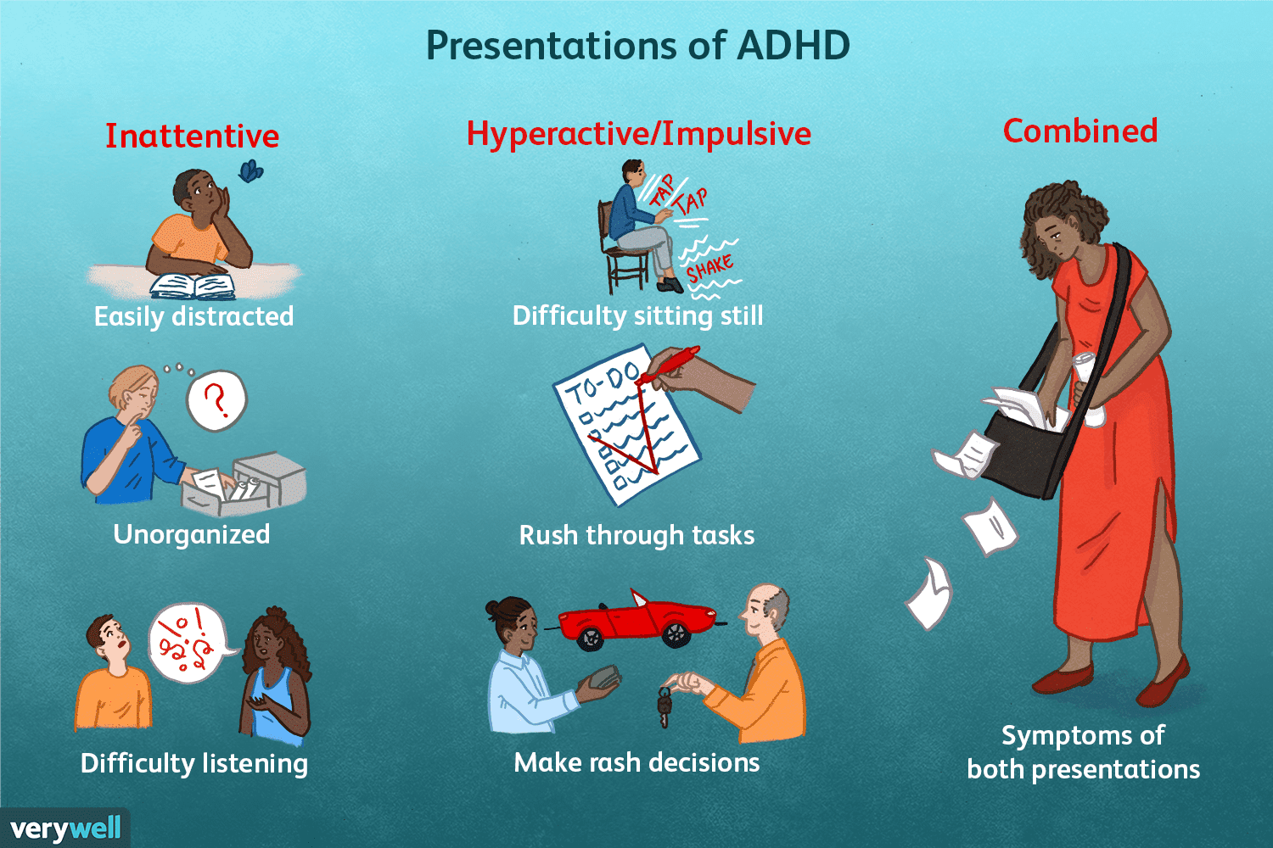
What types of ADHD are there?
Notes:
ICD-10-CM codes for ADHD include:
F90.0, Attention-deficit hyperactivity disorder, predominantly inattentive type
F90.1, Attention-deficit hyperactivity disorder, predominantly hyperactive type
F90.2, Attention-deficit hyperactivity disorder, combined type
F90.8, Attention-deficit hyperactivity disorder, other type
F90.9, Attention-deficit hyperactivity disorder, unspecified type

Slide 4
Statistics Round
1
What Percentage of Children in the UK are estimated to have ADHD
A 2%
B 3%
C 5%
2
What Percentage of Adults in the UK are estimated to have ADHD
A 1%
B 2%
C 3%
3
What Percentage of our prison population is estimated to have ADHD
A30%
B 15%
C 12%
In 1990 only 40 children in the UK were on medical treatment, which means many adults have not been not treated or managed properly
Gender ratio is from 1:3 – 1:16 Female to Male and varies from country to country
Up to 60% of adults who have childhood ADHD will continue to show symptoms into their adult life
Notes:
Question Audience: Ask each question individually and provide all three options to members of the audience. The slide is to raise awareness of how common Dyslexia can be and that it will most likely affect you directly or indirectly in some fashion.
10% or 6.3 Million
16%
30% Estimated (offending rates can be drastically reduced with effective ADHD management)
1872: The first reference of the term Dyslexia occurred in 1872 by the physician Rudolf Berlin from Germany, who used the term to describe the case of an adult with acquired Dyslexia, that is, loss of reading ability due to a brain lesion
ADHD has been known as hyperkinetic disorder (HKD)

Slide 5

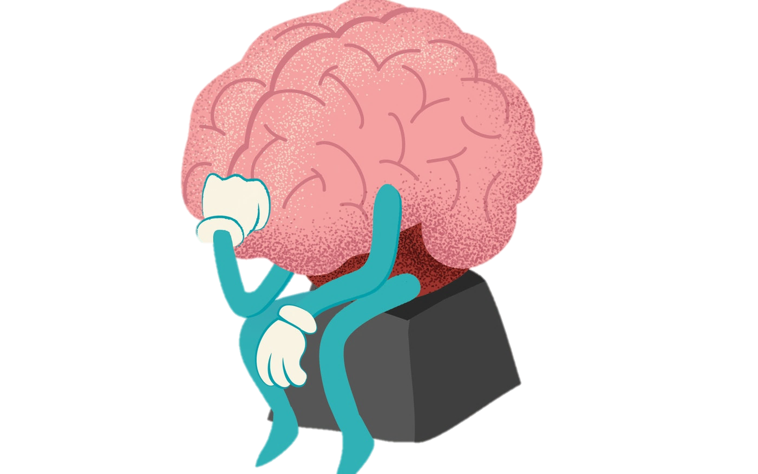
ADHD Symptoms
Attention
Patience
ADHD
What Symptoms could ADHD cause someone to experience?
Time Management
Being able to concentrate for longer periods
Forgetfulness and short term memory issues
Being disorganised
Have difficulty maintaining daily routines
Impulsive behaviour which is often interpreted by others as being thoughtlessness
Impulsive and angry outbursts
Low self esteem which can lead to depression
Poor social skills in some cases
Poor time management
Feeling overwhelmed by everyday tasks
Moving from planning a task to ‘doing’ a task
Having trouble completing a task
Hyperactivity
Boredom blackouts
Procrastination
Interpersonal/social skill issues
Hyperactivity
Memory
Organisation
Changing Activity
Organisation
Impulsiveness
Concentration
Notes:
Slide Content:
Dyslexia incorporates a number of symptoms, not just literacy.
Two people with Dyslexia could both have a diagnosis and completely different symptoms.

Slide 6
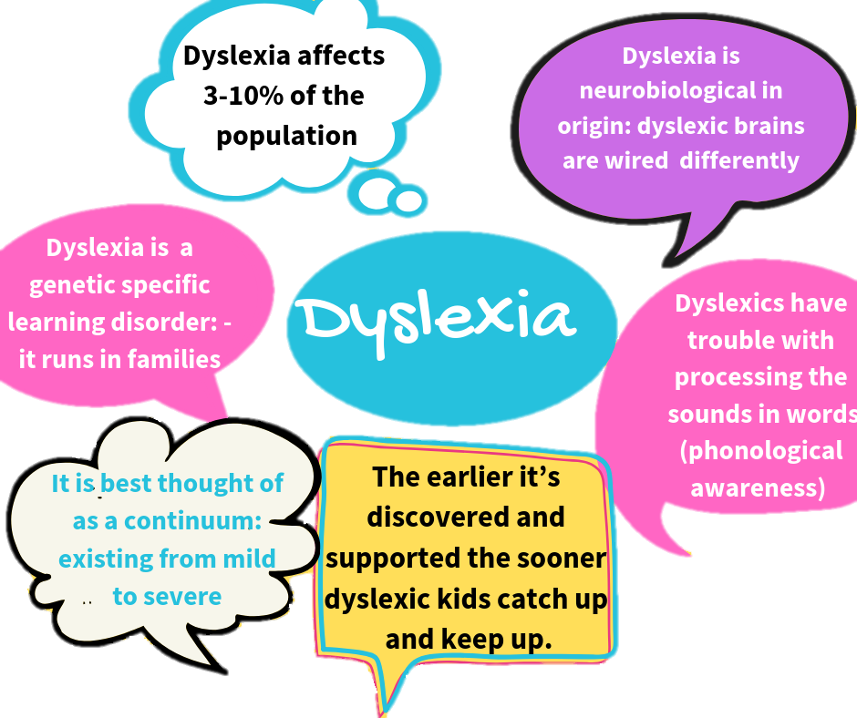
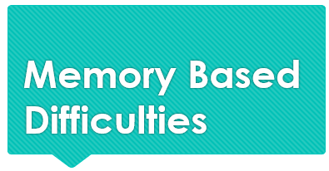

Working Memory
Remembering Names
Some people with ADHD have issues with various forms of memory.
Working Memory specifically has been linked with ADHD
Verbal Instructions
Memory
Remembering details from meetings
Long-term memory
Short-term memory
Notes:
Audience Question: Ask the audience what they think working memory is?
Working Memory is the thinking skill that focuses on memory-in-action: the ability to remember and use relevant information while in the middle of an activity. For example, a person is using their Working Memory as they recall the steps of a recipe while simultaneously cooking a meal.
Slide Content: A good idea here is to suggest a couple of tips of how to remember things easier. For example when leaving your house and forgetting if you locked the door or not, tell people to lock the door and clap their hands or stamp a foot. This breaks the automation of memory and usually will allow a person to remember if they locked the door easier, as clapping your hands is abstract. Tell them to remember someone's name simply try to repeat their name three times in conversation. Suggest its normal to forget someone's name initially, however repeating their name throughout the conversation a couple of times helps store that information.
Another idea is suggesting has anyone been out with friends and someone has began telling a story from the past. Has that friend ever told the story and you were personally there and you think… that’s not what happened. Often people exaggerate stories to make themselves seem funnier or for the story to be more interesting, but a lot of it is to do with how poor our memory and recall is. Your memory isn’t a perfect video tape of events. Your mind fills in gaps with things you are unsure of, from other experiences or simply fabricated situations. Therefore the way you felt it went may even be flawed.

Slide 7


Knowing Logistics
Knowing Left or Right
Some people with ADHD have
issues with their
Communication
This can be for a variety of reasons
Hand Writing
Communication
Clumsy
Dropping Things
Following Directions
Notes:
Slide Content: People with Dyslexia can have issues with both fine and gross motor control, similar to Dyspraxia. This may affect their ability to hand write text due to poor dexterity in their hands/coordination or may cause them to appear clumsy when carrying objects or navigating their surroundings.

Slide 8

Duration of Tasks
Untidy Desk
Some people with ADHD have
issues with Organisation.
Some therefore Struggle to organise their time and materials effectively.
Loosing Common Items
Organisation Difficulties
Being Late
Time
Perception
Time Management
Notes:
Slide Content: Many individuals with Dyslexia have issues with their Time Management & Organisation. This can manifest in a number of ways, including organising a diary, prioritising work, perceiving how long tasks will actually take and being late or forgetting various diary dates. This can be due to a sporadic mind set and seeing the big picture more than a focused state of attention.

Slide 9

Poor
Attention
Unfocused
Some people with ADHD have
issues with their Attention.
Some therefore Struggle to be attentive to specific information or stimulus.
Loosing Common Items
Attention Difficulties
Distracted
by
Conversation
Losing Place
in text
Distracted by Background Noise
Notes:
Slide Content: People with Dyslexia can often find being attentive to literacy based activities very difficult, given the effort and energy required for them to read & write in most cases. This is equally true for activities they may find unappealing or under stimulating.

Slide 10

Processing Information
Processing Speed
Some people with ADHD have other
issues present additionally.
Some therefore struggle with processing information & confidence for instance.
Speech
Issues
Other Difficulties
Mental
Health
Multi-Tasking
Confidence
Notes:
Slide Content: There are many aspects of Dyslexia that may be subjective to one person. Dyslexia is thought to have symptoms more on a continuum than being in a static state. Two individuals with Dyslexia can have very different symptoms, however will evidently share the basic fundamental difficulties in literacy that are the foundation of Dyslexia.

Slide 11







Strengths
Hyper focus
Resourcefulness
Curiosity
Creativity
Intuitive thinking
Quick thinking
Resilience
Positivity
Boundless enthusiasm
Sensitivity
Many people with ADHD have undiscovered strengths

Slide 12

Causes of ADHD
What Causes ADHD??
Nobody knows
The exact cause of ADHD is unknown, but it often appears to run in families.
It's thought certain genes inherited from your parents may act together in a way that affects how some parts of the brain develop during early life. Both environmental and hereditary factors may play a part.
https://giphy.com
Notes:
Slide Content: Dyslexia runs strongly in families suggesting a genetic basis. Genetic studies suggest around 60% is inherited, prevalence across cultures is similar (and independent of socio-economic status and IQ), and more males than females are affected. Nine gene variants associated with Dyslexia have so far been identified and several more suggested. Many of these genes control the development of the brain, leading to differences in brain structure, so that some nerve cells can end up in the wrong places during development. This leads to microscopic differences in connectivity between neurones, and an unusual symmetry of the language areas.
These abnormalities may particularly affect 'magnocellular' neurones which are specialised for timing, sequencing and rapid information processing.
Dyslexics commonly have problems with visually sequencing the letters in a word rapidly and accurately - 'an orthographic deficit' and also with rapidly and accurately ordering the sounds in a word - a 'phonological' deficit. Such impaired sequencing of letters visually and sounds auditorily may result from abnormal magnocellular development.
The gene variants may also make magnocells more vulnerable to immune attack during development of the brain, and to nutritional deficiencies, e.g of the essential 'omega-3' fatty acids that are found in oily fish.
Source: https://www.dyslexic.org.uk/about-dyslexia/what-causes-dyslexia
Ultimately no one knows the exact cause however.

Slide 13

Genetics
However, the way ADHD is inherited is likely to be complex and is not thought to be related to a single genetic fault.
ADHD tends to run in families: genes you inherit from your parents are a significant factor in developing the condition
Research shows that parents and siblings of a child with ADHD are more likely to have ADHD themselves.
Genetic Memory
Genetic Expression

Slide 14
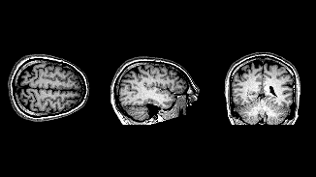
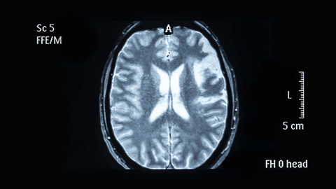
Research has identified a number of possible differences in the brains of people with ADHD from those without the condition
Brain scans suggest that areas of the brain may be smaller in people with ADHD and other areas may be larger.
Brain Function and Structure
Other studies have suggested that people with ADHD may have an imbalance in the level of neurotransmitters in the brain, or that these chemicals may not work properly.
Head Injury's, Prenatal exposures, Significant head injuries
There is no evidence that ADHD is caused by:
Eating too much sugar, Food additives, Allergies or Immunizations,

Slide 15
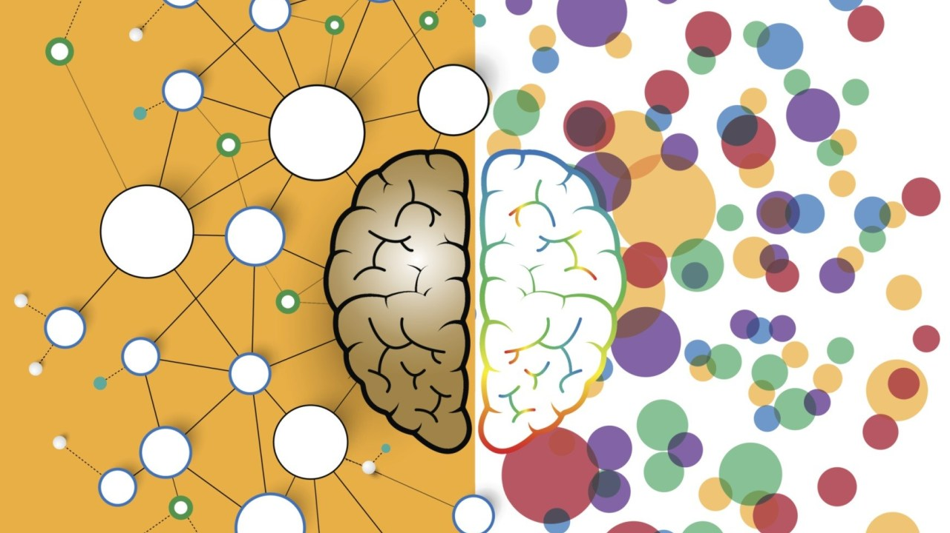
ADHD & Dopamine
How do you feed your chemical reward system?
Dopamine allows us to regulate emotional responses and take action to achieve specific rewards. It’s responsible for feelings of pleasure and reward.​
Scientists have observed that levels of dopamine are different in people with ADHD than in those without ADHD.​
​
People with ADHD may have a higher concentration of dopamine transporters in the brain. These transporters remove dopamine from brain cells. When there are more transporters in one area of the brain, they do this too quickly, which means that dopamine has less time to exert its effects.
Notes:
Dopamine allows us to regulate emotional responses and take action to achieve specific rewards. It’s responsible for feelings of pleasure and reward.
Scientists have observed that levels of dopamine are different in people with ADHD than in those without ADHD.
People with ADHD may have a higher concentration of dopamine transporters in the brain. These transporters remove dopamine from brain cells. When there are more transporters in one area of the brain, they do this too quickly, which means that dopamine has less time to exert its effects.

Slide 16

Treatment
Medication
There are 5 types of medication licensed for the treatment of ADHD:
Methylphenidate (Ritalin)
Dexamfetamine
Lisdexamfetamine
Guanfacine
Atomoxetine
Stimulants (first 4), which work by increasing activity and Dopamine Levels in the brain, particularly in areas that play a part in controlling attention and behaviour.
Noradrenaline Reuptake Inhibitor (SNRI), which means it increases the amount of a chemical in the brain called noradrenaline. This chemical passes messages between brain cells, and increasing it can aid concentration and help control impulses.
Possible Side affects
Tiredness or fatigue
Headache
Abdominal pain
Dry mouth
Irritability
Nausea and vomiting
Decreased appetite

Slide 17

Treatment
Therapy
There are various types of therapy as a form of treatment for ADHD:
Psychotherapy
Cognitive Behavioural Therapy (CBT)
Psychoeducation
Psychological Counselling
Marital Counselling and Family Therapy
Behaviour therapy
Social skills training
Support groups

Slide 18
Treatment
Other Treatments
Diet
Keep a diary of what you eat and drink, and what behaviour follows. You may referred to a dietitian
Supplements
Omega-3 and Omega-6 fatty acids may be beneficial aid concentration, magnesium (sleep), saffron,
Co-Morbidity
Personality Disorder
Bi-Polar Disorder
Mental Health Conditions
Obsessive Compulsive Disorder

Slide 19
Distractibility
Problems with external distractibility (noises and movement in the surrounding environment) and internal distractibility (daydreams) can be the biggest challenge for adults with ADHD. The following strategies may help:
Request a private office or quiet cubicle, or take work home or work when others are not in the office.
Use “white noise” earphones, classical music or other sounds to drown out office noises.
Work in unused space, such as a conference room, where distractions are few.
Route phone calls directly to voicemail, and respond to them at a set time every day.
Jot down ideas in a notebook to avoid interruption of the current task.
Keep a list of ideas that come to you during meetings so that you can communicate more effectively.
Perform one task at a time. Do not start a new task until the current one is done.

Slide 20
Impulsivity
Adults with ADHD may struggle with impulsivity and temper outbursts in the workplace. Try the following strategies:
Learn to use self-talk to monitor impulsive actions.
Work with a coach to role-play appropriate responses to frustrating situations.
Ask for regular, constructive feedback as a way of becoming more aware of how impulsivity might manifest in you.
Practice relaxation and meditation techniques.
Anticipate the problems that regularly trigger impulsive reactions and develop routines for coping with these situations.

Slide 21
Hyperactivity
Adults with the hyperactive presentation of ADHD often do better in jobs that allow a great deal of movement, such as sales, but if you have a sedentary job, the following strategies may help:
Take intermittent breaks to do photocopying, go to the mailroom, or walk to the water fountain.
Take notes in meetings to prevent restlessness.
Move around, exercise, take a walk, or run up and down the stairs.
Bring lunch―instead of going out to buy it―so the lunch hour can be a time for exercise.

Slide 22
Poor Memory
Failing to remember deadlines and other responsibilities can antagonize co-workers, especially when working on a team. To improve memory, try the suggestions below:
Use tape recording devices or take copious notes at meetings.
Write checklists for complicated tasks.
Use a bulletin board or computer reminder list for announcements and other memory triggers.
Learn how to use a day planner and keep it with you to keep track of tasks and events.
Write notes on sticky pads and put them in a highly visible place.

Slide 23
Boredom-Blockouts
Because of their strong need for stimulation, some adults with ADHD become easily bored at work, especially with detailed paperwork and routine tasks. To prevent boredom, try the following tips:
Set a timer to stay on task.
Break up long tasks into shorter ones.
Take breaks, drink water, get up and walk around.
Find a job with stimulating responsibilities and minimal routine tasks.

Slide 24
Time management difficulties
Managing time can be a big challenge for adults with ADHD. Here are some guidelines for improving time management skills:
Use time-line charts to break large projects into smaller pieces, with step-by-step due dates.
Reward yourself for achieving each due date.
Use watch devices with alarms, buzzers, planners or computer planning software.
Program your computer to beep 5 minutes before every meeting on the calendar.
Avoid over-scheduling the day by overestimating how long each task or meeting will take

Slide 25
Procrastination
Putting things off not only prevents completion of tasks, but also creates problems for others on the team. Here are some strategies for success:
Break the task into small pieces, rewarding yourself along the way. (Rewards need not be grand; they might be a new CD, a long walk with your dog, dancing or whatever you enjoy.) It may be helpful to have a coach or someone else to whom you can report and be accountable for achieving each piece of the task, until you learn to overcome your tendencies to procrastinate. See the National Resource Center’s information on coaching for more information on how a coach can help.
Ask the supervisor to set a deadline for tasks.
Consider working on a team with a co-worker who manages time well.

Slide 26
Paperwork/details
The inability to find important papers, turn in reports and time sheets, and maintain a filing system can create the impression of carelessness. If paperwork is a significant part of the job, try these tips:
Make it a rule to handle each piece of paper only once.
Ask an administrative assistant to handle detailed paperwork.
Keep only those papers that are currently in use; purge the rest.
Make filing more fun by colour coding folders and using catchy labels

Slide 27
Interpersonal/social skill issues
Individuals with ADHD may unintentionally offend co-workers by interrupting frequently, talking too much, being too blunt, or not listening well. If social skills are a challenge, try the following strategies:
Ask others for feedback, especially if there is a history of problems with colleagues and supervisors.
Learn to pick up on social cues more readily. Some adults with ADHD have a hard time picking up nonverbal cues that they are angering a co-worker or supervisor.
Work with a coach to determine what types of settings often lead to interpersonal/social issues.
Look into personality types and how your type interacts with other types

